Slide 1
Reaction SMC 11T#3 04/06/2014
N.Bourcey 17/06/2014

Slide 2
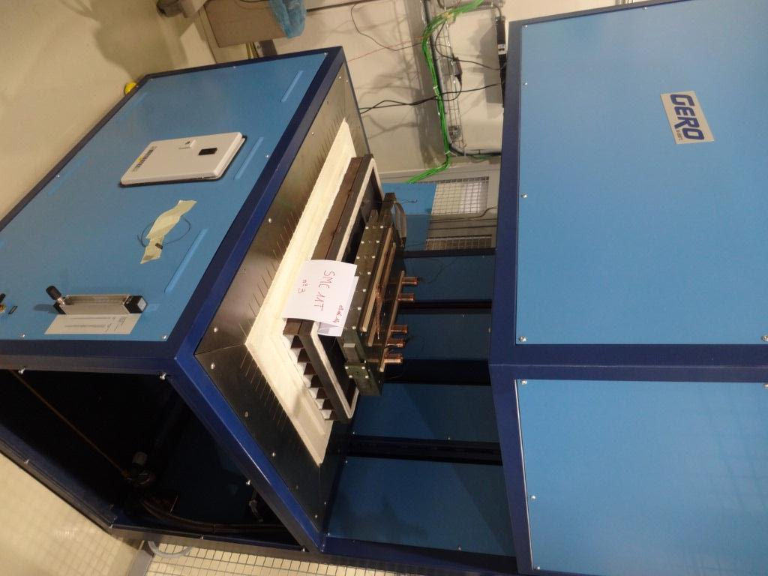
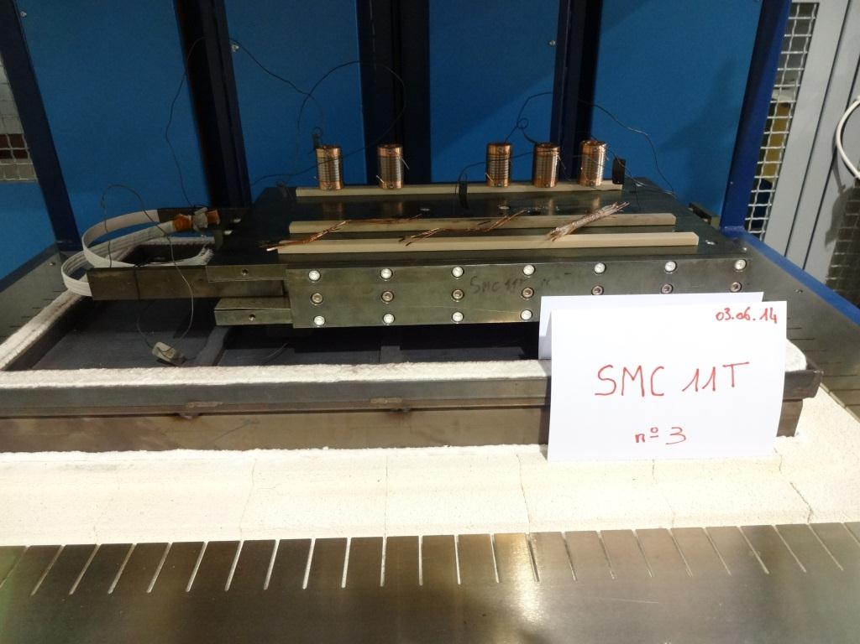
Preparation
Heat cycle :
Ramp up 50°C/h, hold 48h/210°C
Ramp up 50°C/h, hold 48h/400°C
Ramp up 50°C/h, hold 40h/650°C

Slide 3
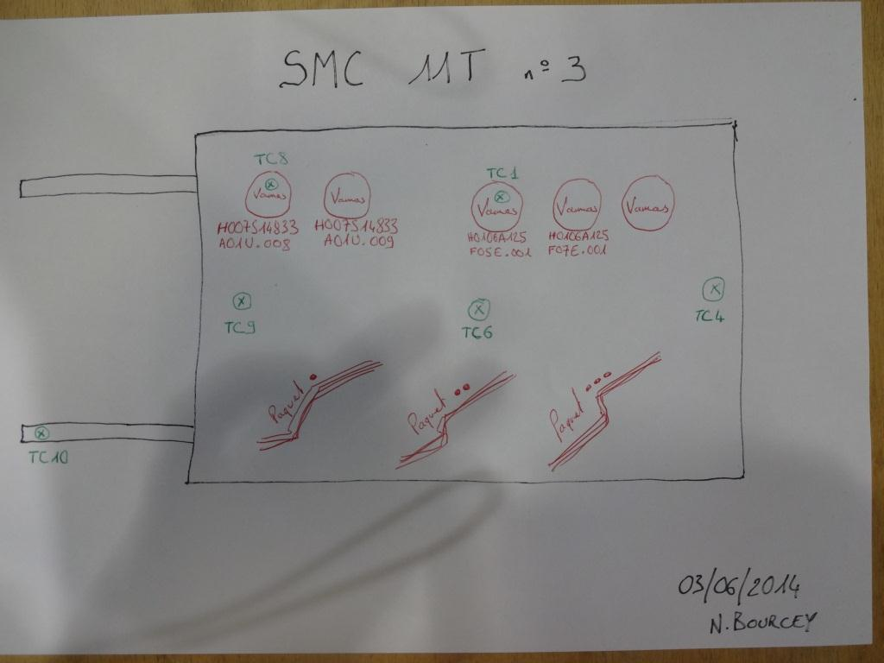

Slide 9
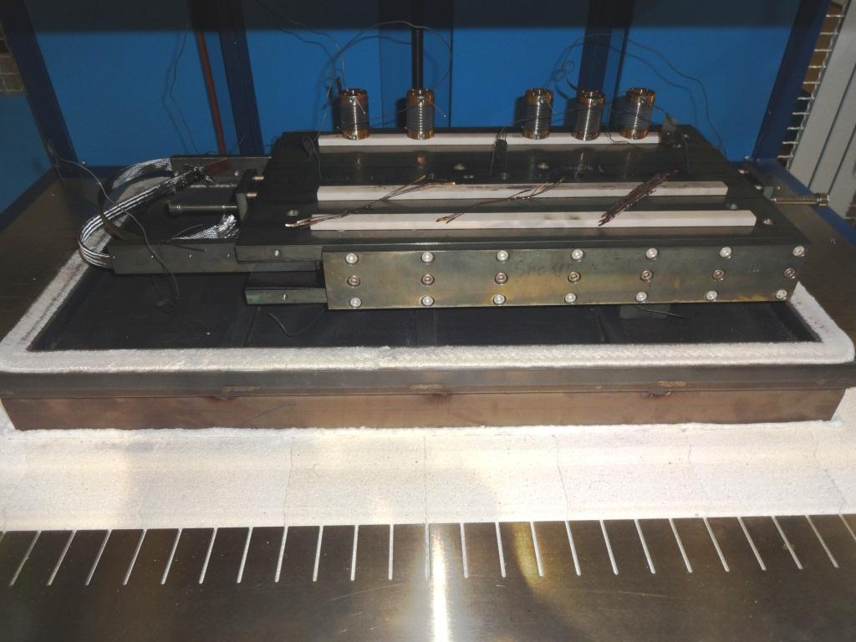
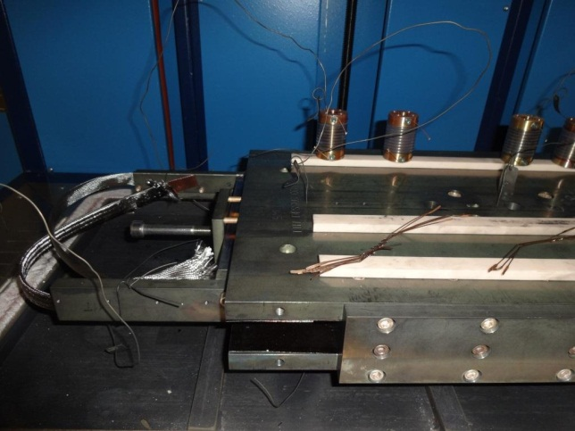
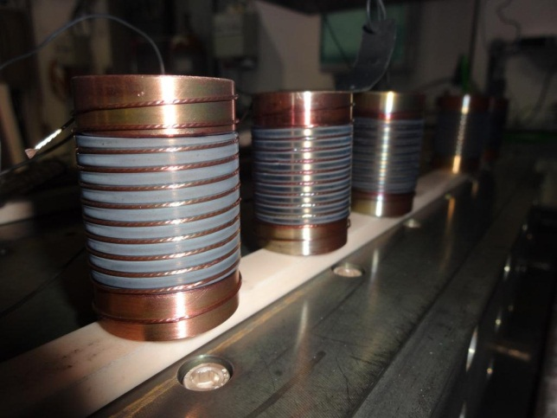
Conclusion
Average temperature on dwell at 400°C and 650°C is slightly less than nominal (396°C and 637°C)
Good homogeneity during dwell: ± 1°C
Degradation of the O2 level up to 2500 ppm during cool-down at 250°C during 1h due to lack of argon.

